Slide 1
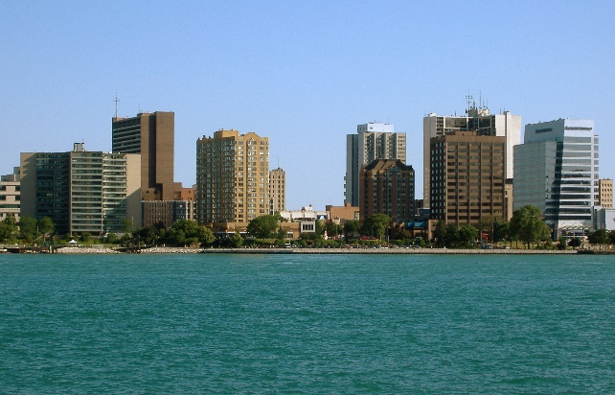
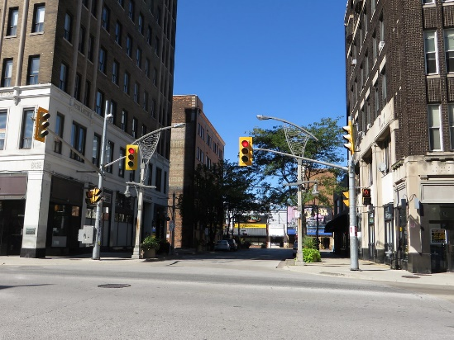
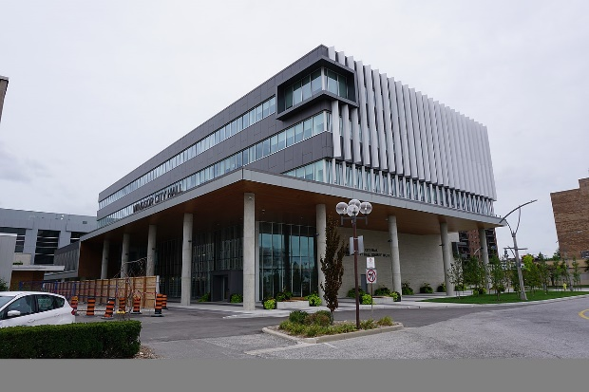


City of Windsor
2020 Development Charges Study
Task Force Meeting #1
Thursday, September 26th, 2019

Slide 2
Today we will discuss...
What are Development Charges?
Bill 108: More Homes, More Choices Act
DCs in Windsor
Study Process
DC Policy Considerations
Next Steps

Slide 3
What Are Development Charges?
Fees imposed on development to fund “growth-related” capital costs
DCs pay for new infrastructure and facilities to maintain service levels
Principle is “growth pays for growth”

Slide 4
What Are Development Charges?
DCs are imposed by by-law
Maximum life of a DC by-law is 5 years after the day it comes into force (may be repealed/amended earlier)
  The City’s by-law 60-2015 expires on June 2, 2020
Prior to passing a by-law City must
  undertake a background study
  hold at least one public meeting
Appeals adjudicated at LPAT (OMB)

Slide 5
Key Legislation
Development Charges Act 1997 (DCA)
  Bill 73 “An Act to amend the Development Charges Act, 1997 and the Planning Act” received royal assent Dec 3, 2015
Ontario Regulation 82/98
  Amended by O. Reg. 428/15
Bill 108
  Received Royal Assent on June 6

Slide 6
Bill 108: More Homes, More Choice Act Received Royal Assent June 6
Changes 15 pieces of legislation including DCA and Planning Act
Key DCA changes
  DC exemptions for secondary suites in new construction
  DC rates frozen at site plan/rezoning application
  DCs payable in annual installments from occupancy for non-residential development and non-profit/rental housing
  Discounted “soft” services removed from DCA framework

Slide 7
Overview of DCA
Charges levied on a service basis
City given discretion to define services
Bill 108
  Can recover 100% of eligible costs
  Can control planning periods

Slide 8
Bill 108 DCA Changes:
Eligible Services Now Prescribed
Water supply services
Waste water services
Storm water drainage and control services
Services related to a highway
Electrical power services
Policing services
Ambulance services
Fire protection services
Transit services
Waste diversion services*
Services in bold are relevant to the City of Windsor
*Waste services to be considered under 2020 DC Background Study

Slide 9
Bill 108
Community Benefits Charges
“Soft” services to be removed from DC framework (except transit, waste, and ambulance, which will now be 100% cost eligible)
Replaced by a “Community Benefits Charge” (CBC) under Planning Act
CBCs
  Require a “strategy” with list of projects
  Charges based on value of development site (% prescribed by Reg.)
  s.37 provisions (density bonusing) removed
  Can either have CBCs or utilize s.42 (parkland dedication & cash-in-lieu), but not both

Slide 10
Proposed Transition Window
Proposed transitional policies:
  CBC authority comes into force Jan. 1, 2020
  Municipalities can no longer charge for soft services DCs as of Jan. 1, 2021
Consultation is ongoing and final regulations will confirm these details

Slide 11
Windsor DC Rate Structure
Service | Maximum DC Cost Recovery | Maximum Planning Period | Planning Period Used in 2015 DC Study | Bill 108 Implications
Discounted Services
General Government | 90% | 10 years | 10 years | Partially Impacted
Library Board | 90% | 10 years | 10 years | Removed
Indoor Recreation | 90% | 10 years | 10 years | Removed
Park Development | 90% | 10 years | 10 years | Removed
Parking | 90% | 10 years | 10 years | Removed
Non-Discounted Services
Fire Services | 100% | Unlimited | 10 years | Unchanged
Police | 100% | Unlimited | 10 years | Unchanged
Public Works and Fleet | 100% | Unlimited | 10 years | Unchanged
Transit | 100% | 10 years | 10 years | Unchanged
Roads and Related | 100% | Unlimited | 10 years | Unchanged
Sanitary Sewer | 100% | Unlimited | 10 years | Unchanged
Storm Sewer & Municipal Drains | 100% | Unlimited | 10 years | Unchanged
Water | 100% | Unlimited | 10 years | Unchanged

Slide 12
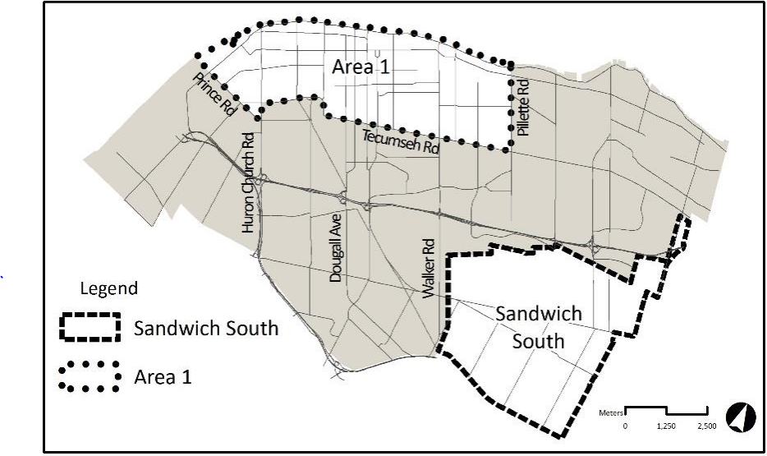
Area Map
Exempt from Engineered Services charges
City-wide DC rates apply
Area-specific Engineered Services charges apply

Slide 13
Development Charges in Windsor
Planning Area | Residential Charge per Unit |  |  | Non-Residential Charge per Square Metre
 | Single Detached | Semis, Rows & Other Multiples | Apartments | Industrial | Non-Industrial
City-wide | $29,205 | $20,734 | $13,960 | $0.00 | $132.00
Area 1 | $2,217 | $1,572 | $1,061 | $0.00 | $2.98
Sandwich South | $42,951 | $29,046 | $20,601 | $0.00 | $169.18

Slide 14
What Do DCs Fund in Windsor?
City-Wide Residential Charges Per Unit
Single Detached $29,205
Semis, Rows & Other Multiples $20,734
Apartments $13,960
Ineligible Services % of Charge 5.4%

Slide 15
What Do DCs Fund in Windsor?
City-Wide Non-Residential Charge Per Square Metre
Industrial $0.00
Non-Industrial 138.87
Ineligible Services % of Charge 0.5%

Slide 16
Overview of Study Process
Anticipated amount, type and location of development must be estimated
Development Forecast
Increase in need may not exceed average level of service immediately preceding background study
Calculate 10-Year Historical Service Levels
Increase in the need for service attributable to the anticipated development must be estimated
Identify Growth-related Capital Needs
Reduce capital costs by legislated deductions
Grants/Other
Contributions
Required Service Discount
Replacement/
Benefit to Existing
Available DC Reserves
Post-Period Benefit
Costs Eligible for DC Recovery
Operating & Replacement Cost Analysis (Incl. AMP)
Allocation of eligible costs by type of development
Residential Sector
(per unit)
Non-Residential Sector (per m² of GFA)

Slide 17
Coordination with Sandwich South Growth Management Study
Hemson is currently assisting City planning staff with a Growth Management Study for the Sandwich South Planning District
Study objectives:
  Assess the development potential of Sandwich South
  Provide a framework for future sub-area Secondary Plans & engineering studies
  Consider potential infrastructure financing needs & fiscal impacts
DC & Growth Management study processes will be coordinated as appropriate

Slide 18
Key Steps in Passing a DC By-law
Release background study 60 days prior to by-law passage (including on website)
Advertise public meeting
Release DC study and proposed by-law
  Hold statutory public meeting
  Receive feedback and amend proposed charges and by-law if warranted
  Determine if additional public meeting is required
  By-law passage

Slide 19
Proposed Project Timeline
Summer 2019
October 2019
Staff Kick-off Meetings
Finalize Development Forecasts
September 2019
Nov. – Dec. 2019
Jan. – Feb. 2020
Preliminary Service Level Analysis
Individual Department Meetings
Task Force Meeting #1: Project Introduction
Mar. – Apr.
2020
Respond to Written Submissions
Council Passage of DC By-law
Preliminary Development Forecasts
Background Review & Info Requests
Finalize Service Level Analysis
Complete Draft Capital Programs
Task Force Meeting #2: Forecasts & Capital Programs
Preliminary DC Rate Calculation
Prepare DC Background Study & By-law
Task Force Meeting #3: Draft Rates & Policy Recommendations
Council Info Session
Finalize DC Rates
Statutory Public Meeting
TBD (2020)
CBC By-law Passage
Prepare CBC Strategy & By-law
Sept. 26
Sept. 26-27
Notes:
***CBC schedule TBD – process dependent on regulations.
(Will prepare capital programs in line with DC study process)

Slide 20
Current DC By-law Policies
Statutory exemptions
  Land owned and used by City and school boards
  Enlargement of existing residential dwelling and creation of additional dwelling per O.Reg. 82/89
  Enlargement of existing industrial development (by 50% or less)
Discretionary exemptions
  Conversion of existing buildings from a commercial, institutional or industrial use to a residential use
  Parking garage or portions of development devoted to parking
  Industrial use
  Colleges and universities
  Brownfield redevelopment (partial)
  Infill development (partial)

Slide 21
DC Policy Considerations
Area rating
  Maintain area-specific approach to engineered services rates for Sandwich South?
Non-Statutory DC exemptions & discounts
Structure of charge
Local services policies & developer costing agreements
Annual DC index date
  Currently June 1
  Suggest moving to less busy time of year (Jan. 1?)

Slide 22
Next Steps
  Individual department meetings: Sept 26-27
  Prepare development forecasts
    City-wide & area-specific
    Coordination with Sandwich South Growth Management Study
  Develop capital programs
  Next Task Force Meeting: Late Nov. 2019

Slide 23
Hemson Contacts
  Craig Binning, Project Manager
    416-593-5090 ext. 20; cbinning@hemson.com
  Julia Cziraky, Consultant
    416-593-5090 ext. 25; jcziraky@hemson.com
  Courtney King, Consultant
    416-593-5090 ext. 38; cking@hemson.com

