Slide 1
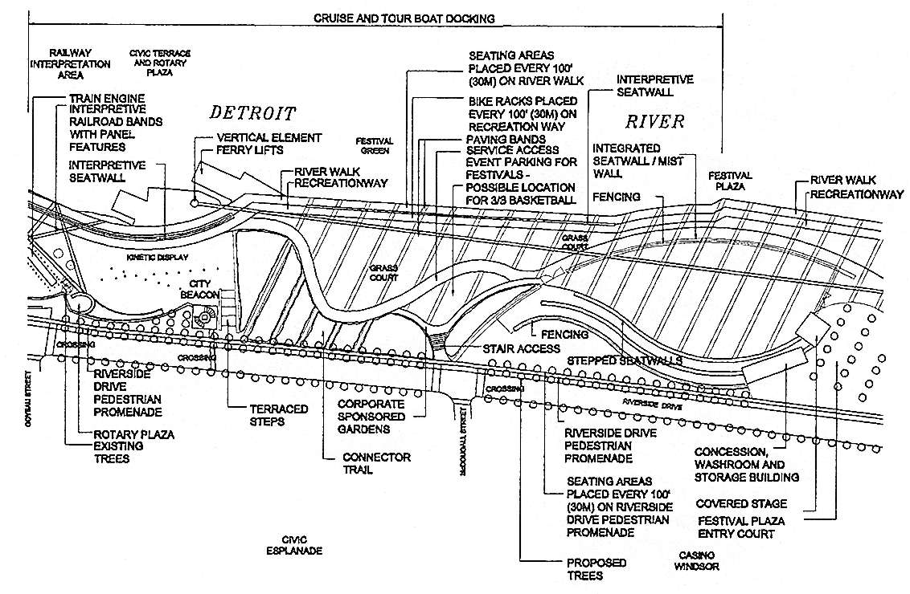

Slide 2
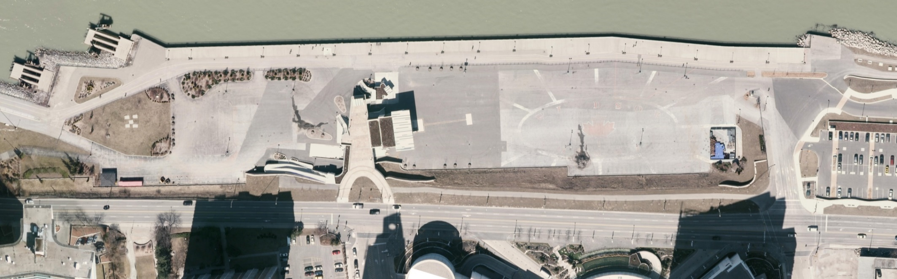

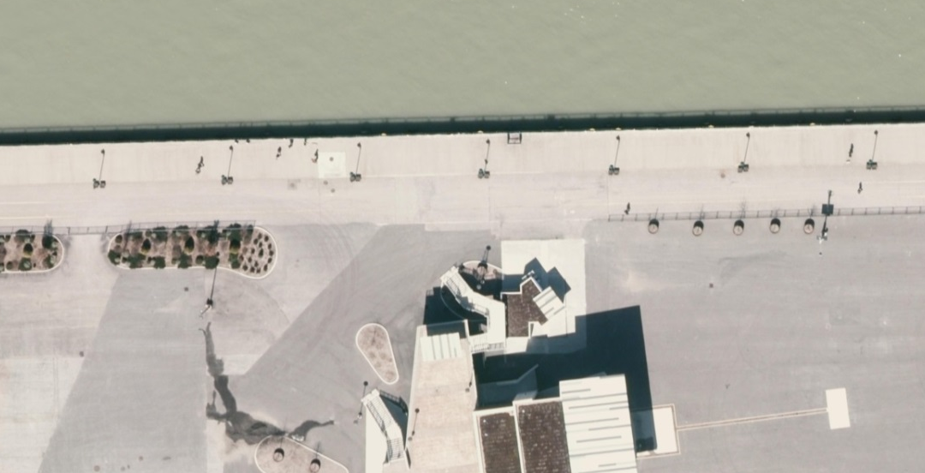
SEE DETAIL ‘A’
RIVERFRONT TRAILS CLOSED
DURING EVENTS
EXISTING PLAZA ENTRANCE
STAIRS CLOSED DURING EVENTS
GLENGARRY AVE.
CURRENT SITE CIRCULATION
RIVERSIDE DRIVE EAST
TRAFFIC FLOWS:
TRAIL USERS
FESTIVAL SUPPORT VEHICLES
FESTIVAL PATRONS
DETROIT RIVER
WINDSOR RIVER CRUISES DOCKING LOCATION (APPROX.)
BOAT PASSENGER LOADING/UNLOADING ZONE AND QUEUING AREA
RIVERFRONT TRAILS CLOSED
DURING EVENTS
Existing Site Circulation Conflicts
EXISTNG PLAZA ENTRANCE
TICKET BOOTH
DETAIL ‘A’ - CURRENT SITE CIRCULATION ADJACENT TO FESTIVAL PLAZA ENTRANCE

Slide 3
RE-LOCATE WINDSOR RIVER CRUISES DOCKING LOCATION CLOSER TO OUELETTE AVENUE
CLOSE RIVERFRONT TRAILS AND PROVIDE CROSSWALK TO NEW RAMP
CLOSE EXISTING PLAZA ENTRANCE
WINDSOR RIVER CRUISES DOCKING LOCATION (APPROX.)
DETROIT RIVER
RIVERFRONT TRAILS CLOSED
DURING EVENTS
STAIRS CLOSED DURING EVENTS
GLENGARRY AVE.
RIVERSIDE DRIVE EAST
CONSTRUCT NEW RAMP THAT OUTLETS AWAY FROM THE BACK-OF-HOUSE
CONSTRUCT NEW PLAZA ENTRANCE AND ENTRY COURT
TRAFFIC FLOWS:
TRAIL USERS
FESTIVAL SUPPORT VEHICLES
FESTIVAL PATRONS
PROPOSED SITE LAYOUT AND RE-ROUTING PLAN

Slide 4

How big is the space?

Slide 5
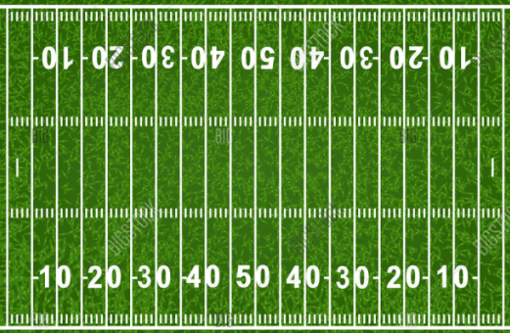
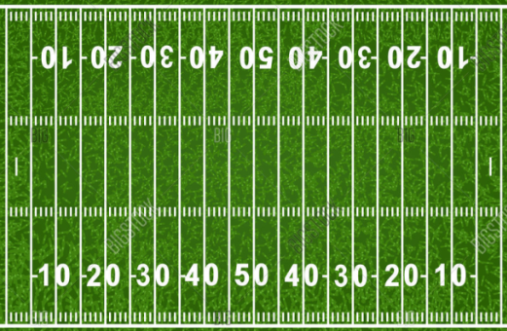
How big is the space?
200 YARDS (190m)

Slide 6

AREA 3:
CONCERT SPACE
AREA 2:
TRANSITION SPACE WITH
SEATING AREAS AND GREEN SPACE
AREA 1:
FLEXIBLE OPEN SPACE WITH ENTRY COURT AND AMENITIES BUIDING
BACK
OF HOUSE
EXISTING STAGE AND FACILITIES BUILDING
RIVERFRONT FESTIVAL PLAZA - PROPOSED SITE AREAS

Slide 7
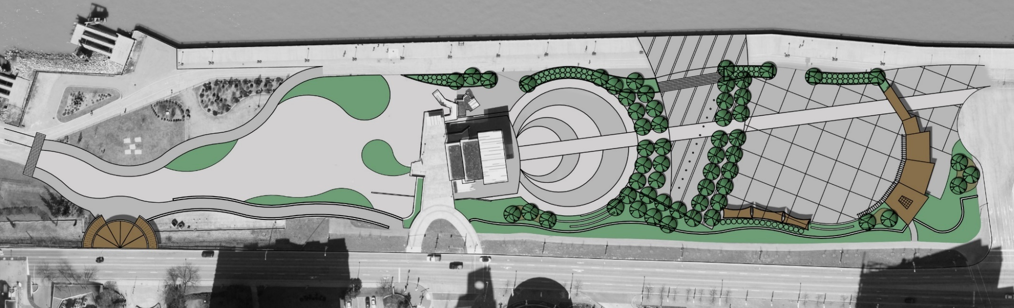

DETROIT RIVER
RIVERFRONT TRAILS (RIVERWALK AND RECREATIONWAY)
ROTARY PLAZA AREA (CONCEPTUAL DESIGN BY OTHERS)
ENTRY COURT
CONCERT AREA
BACK
OF HOUSE
TRANSITION AREA
FLEXIBLE OPEN SPACE
NEW
GLENGARRY AVE.
RECREATIONWAY
RAMP
PEDESTRIAN PROMENADE
RIVERSIDE DRIVE EAST
Updated Concept Plan – without Canopy

Slide 8

DETROIT RIVER
RIVERFRONT TRAILS (RIVERWALK AND RECREATIONWAY)
ROTARY PLAZA AREA (CONCEPTUAL DESIGN BY OTHERS)
ENTRY COURT
BACK
OF HOUSE
CONCERT AREA
TRANSITION AREA
FLEXIBLE OPEN SPACE
NEW
GLENGARRY AVE.
RECREATIONWAY
RAMP
PEDESTRIAN PROMENADE
RIVERSIDE DRIVE EAST
Updated Concept Plan – with Canopy

Slide 9

DETROIT RIVER
RIVERWALK
RIVERFRONT TRAILS
(RIVERWALK AND RECREATIONWAY)
ROTARY PLAZA AREA (CONCEPTUAL DESIGN BY OTHERS)
RECREATIONWAY
BACK OF HOUSE
RAMP
NEW
RECREATIONWAY
RIVERSIDE DRIVE EAST
CROSS WALK
SITE PLAN – BACK OF HOUSE
PAVED BACK-OF-HOUSE AREA
RETAINING WALLS ALONG RAMP
STAIRS FROM RIVERSIDE DRIVE PEDESTRIAN PROMENADE TO RECREATIONWAY
POTENTIAL FOR PEDESTRIAN UNDERPASS CONNECTION TO THE CIVIC ESPLANADE
Updated Concept Plan – Back of House Area

Slide 10
PLAZA ACCESS
FLEXIBLE OPEN SPACE
PLAZA ACCESS
WATER FEATURE (WATER JETS)
RAISED PLANTER BUFFER WITH SEATWALLS
RAISED PLANTER BUFFER WITH SEATWALLS
RAISED PLANTER BUFFER WITH SEATWALLS
STAIRS TO
UPPER LEVEL
2-TIER ENTRANCE CANOPY
DETROIT RIVER
RIVERFRONT TRAILS
(RIVERWALK AND RECREATIONWAY)
ENTRY COURT
BACK OF HOUSE
DROP OFF
GLENGARRY AVE.
RIVERSIDE DRIVE EAST
PEDESTRIAN PROMENADE
SEATWALLS
SEATWALLS
AMENITIES BUILDING
RAMP
CONCERT AREA
SLOPING TOWARD THE STAGE
RETAINING
WALL
ROOF TERRACE
EXISTING STAGE AND FACILITIES BUILDING
RETAINING WALL
SHADE STRUCTURES
TRANSITION SPACE WITH CANOPY TREES
Updated Concept Plan – Festival Plaza

Slide 11
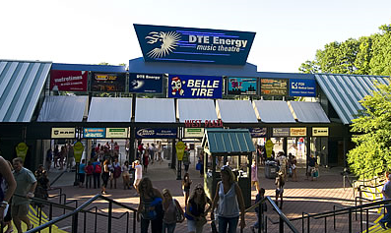
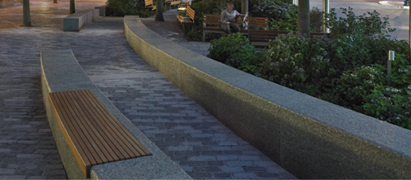
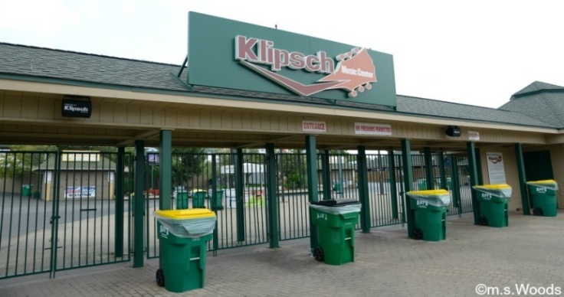
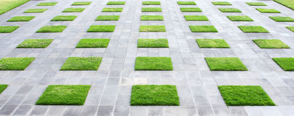
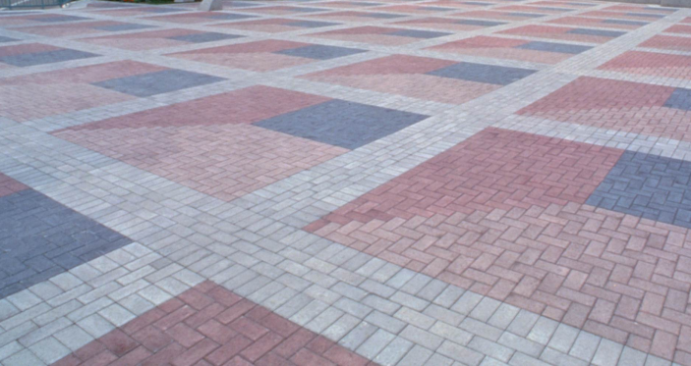
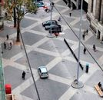
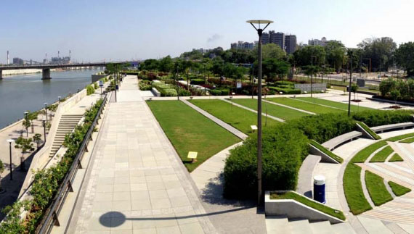
Large, flat open space.
Pavement banding (with grass or different pavement colours/materials)
Building for washroom, storage and concessions.
Flat area for portable toilets required for large events.
Entry canopy or structure to welcome into the site.
Berms and shade trees along the sides to separate Riverwalk and obscure views into the site.
SEATWALLS AND PLANTERS TO SEPARATE PLAZA SPACE FROM THE RIVERWALK
PAVEMENT BANDING, DIFFERENT COLOURS/TEXTURES AND TURF INSETS/BANDING
SITE ENTRANCE WITH SIGNAGE AND FLEXIBLE GATE OPTIONS
Area 1 - Flexible Open Space Area: Concept & Examples

Slide 12
SITE ENTRANCE WITH SIGNAGE AND FLEXIBLE GATE OPTIONS
Area 1 - Flexible Open Space Area: Concept & Examples

Slide 13
SITE ENTRANCE WITH SIGNAGE AND FLEXIBLE GATE OPTIONS
Area 1 - Flexible Open Space Area: Concept & Examples

Slide 14
SITE ENTRANCE WITH SIGNAGE AND FLEXIBLE GATE OPTIONS
Area 1 - Flexible Open Space Area: Concept & Examples

Slide 15
SITE ENTRANCE WITH SIGNAGE AND FLEXIBLE GATE OPTIONS
Area 1 - Flexible Open Space Area: Concept & Examples

Slide 16
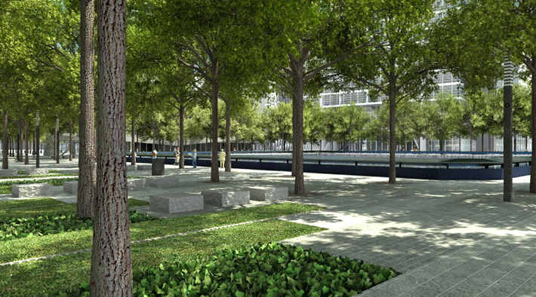
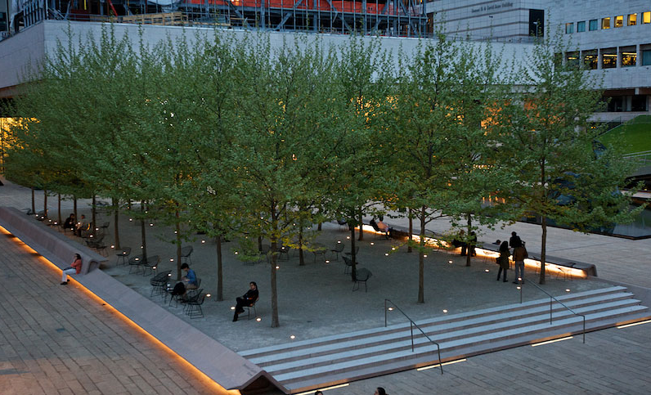
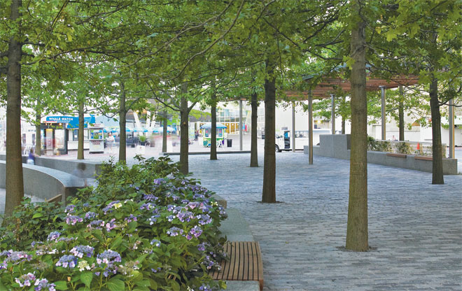
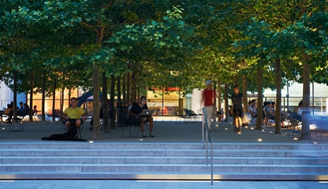
Canopy trees provide shade.
Views through the site are maintained.
Pavement areas with potential to incorporate some grass and planting beds.
Seatwalls / benches / built-in seating.
Provides screening of the site from Riverside Drive.
Up-light trees at night.
Planters to separate the Riverwalk from the plaza area.
BUILT IN SEATING AREAS, GRASS AREAS, LARGE PAVEMENT AREA
CANOPY TREES, PLANTER/SEATWALLS TO SEPARATE SPACES
RAISED AREA, CANOPY TREES WITH UPLIGHTS, SEATING AREAS
Area 2 – Transition Space Area: Concept & Examples

Slide 17
Area 2 – Transition Space Area: Concept & Examples

Slide 18
Area 2 – Transition Space Area: Concept & Examples

Slide 19
Area 2 – Transition Space Area: Concept & Examples

Slide 20
Area 2 – Transition Space Area: Concept & Examples

Slide 21
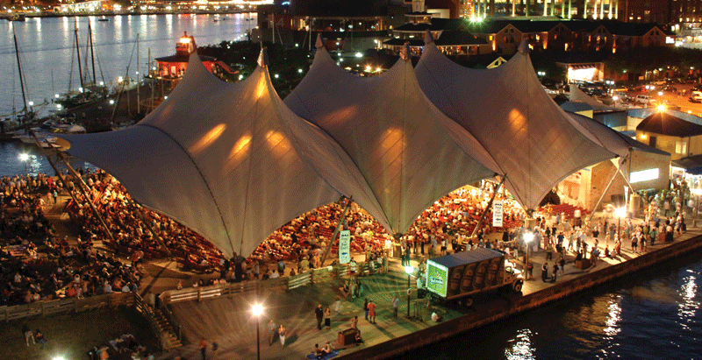
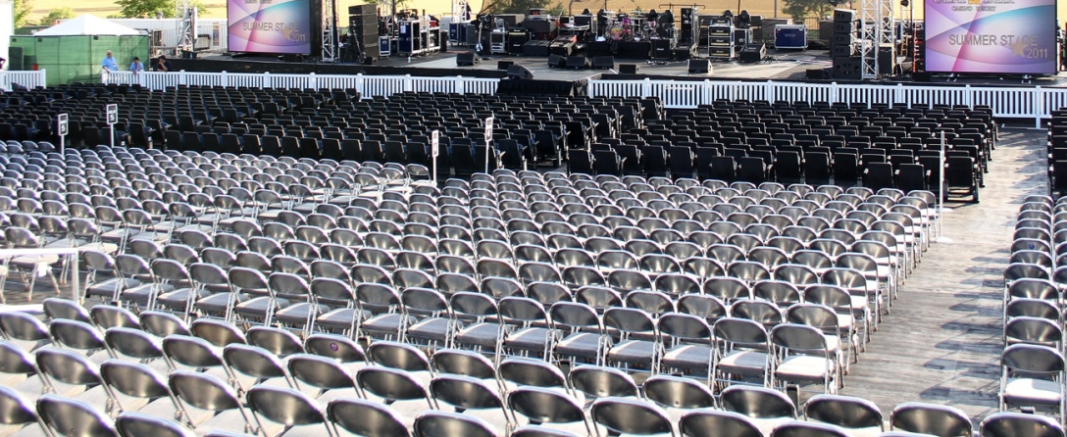
Gently sloping concrete area (approx. 3% slope)
Area to accommodate seating for approx. 1800 people.
Sloped concrete provides better views of the stage vs. existing flat concrete area.
Curved toward the stage provides better views of the stage.
Creates grade change within the site.
Grade change blocks views of the stage from the Riverwalk.
Potential for canopy or roof structure over the seating area.
ROOF STRUCTURE/CANOPY OVER CONCERT SEATING AREA
GRADUAL SLOPING CONCRETE WITH FLAT AREA IN FRONT OF THE STAGE
Area 3 – Concert Space Area: Concept & Examples

Slide 22
ROOF STRUCTURE/CANOPY OVER CONCERT SEATING AREA
Area 3 – Concert Space Area: Concept & Examples

Slide 23
ROOF STRUCTURE/CANOPY OVER CONCERT SEATING AREA
Area 3 – Concert Space Area: Concept & Examples

