Slide 1
Cycling infrastructure spending 2017
Per CR627/2016 Windsor Council Report

Slide 2
CR627/2016
Decision Number: CR627/2016 ETPS 415
That a total of $4,321,000 noted in Figure 1 attached (excluding Cabana Rd. Project W2) BE ALLOCATED for the completion of the Windsor Loop, Community Connections.
Decision Number: CR628/2016
That $2,479,000 BE ALLOCATED to the Dougall/CN portion of the Central Box area which includes the Geo-technical/Engineering and design portion and the drainage works, property acquisitions and utility impacts.
TOTAL = $6,800,000

Slide 3
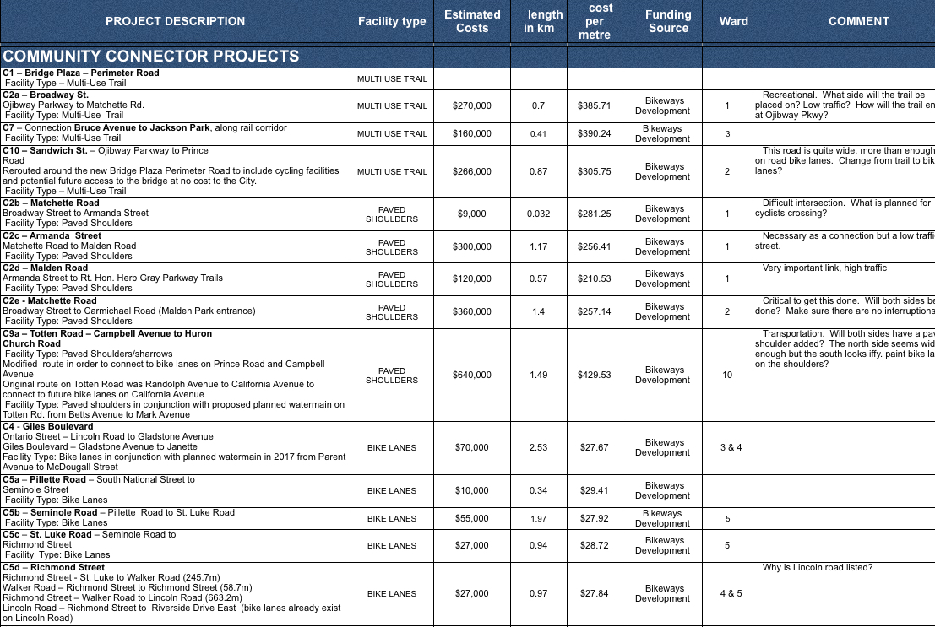
We listed the projects and calculated the cost per metre but all the projects are still difficult to visualize

Slide 4
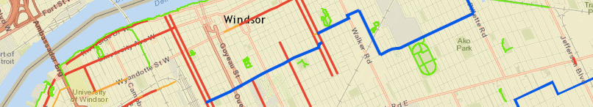
WEbike developed a web map showing the location, cost and detail of all the projects
We spread the word about the new cycling infrastructure through social media, group meetings, newsletter and individual discussions and solicited feedback about the planned infrastructure projects
We received a lot of positive responses but many questions and concerns too. Community members are very pleased to see significant investment but many questioned if some of the projects could be considered cycling infrastructure
The following recommendations summarize the feedback we received from community members

Slide 5
Recommendation #1
Connect cycling infrastructure under the Ambassador Bridge. Add on-road directional paint and signage at intersections. Ensure cycling infrastructure is an integral part of the new Sandwich Street roundabout.

Slide 6
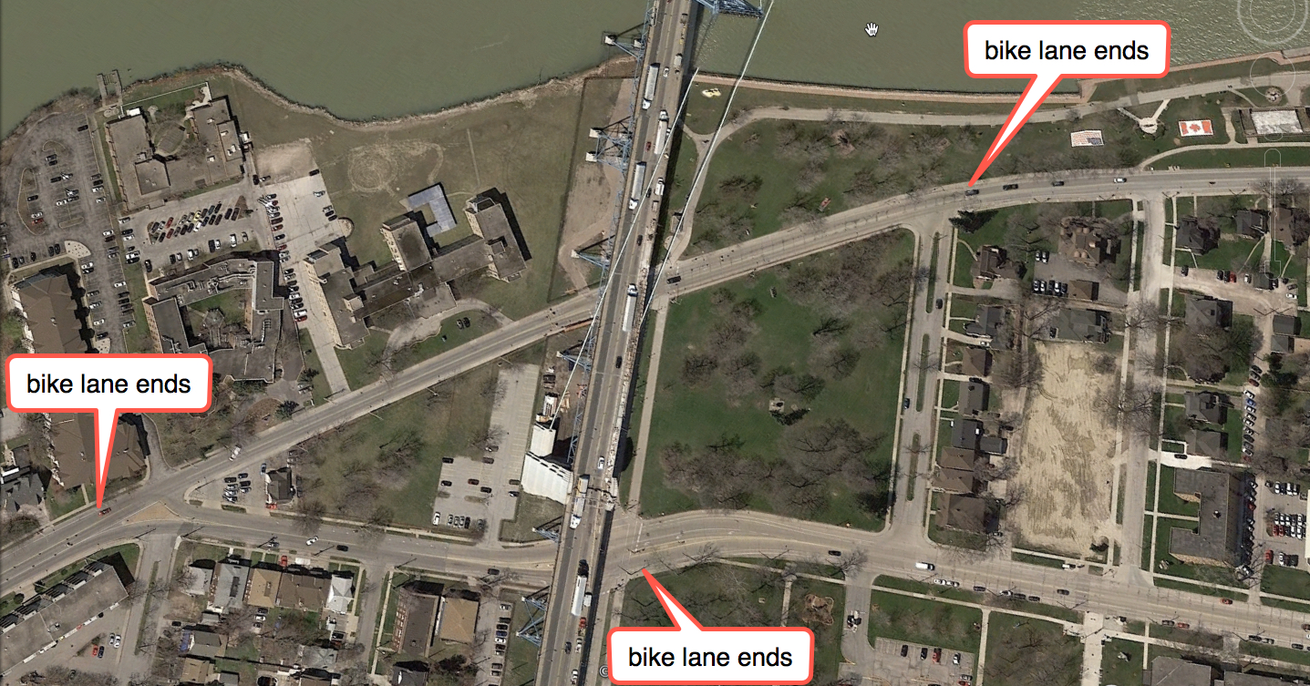
AMBASSADOR BRIDGE CONNECTION

Slide 7
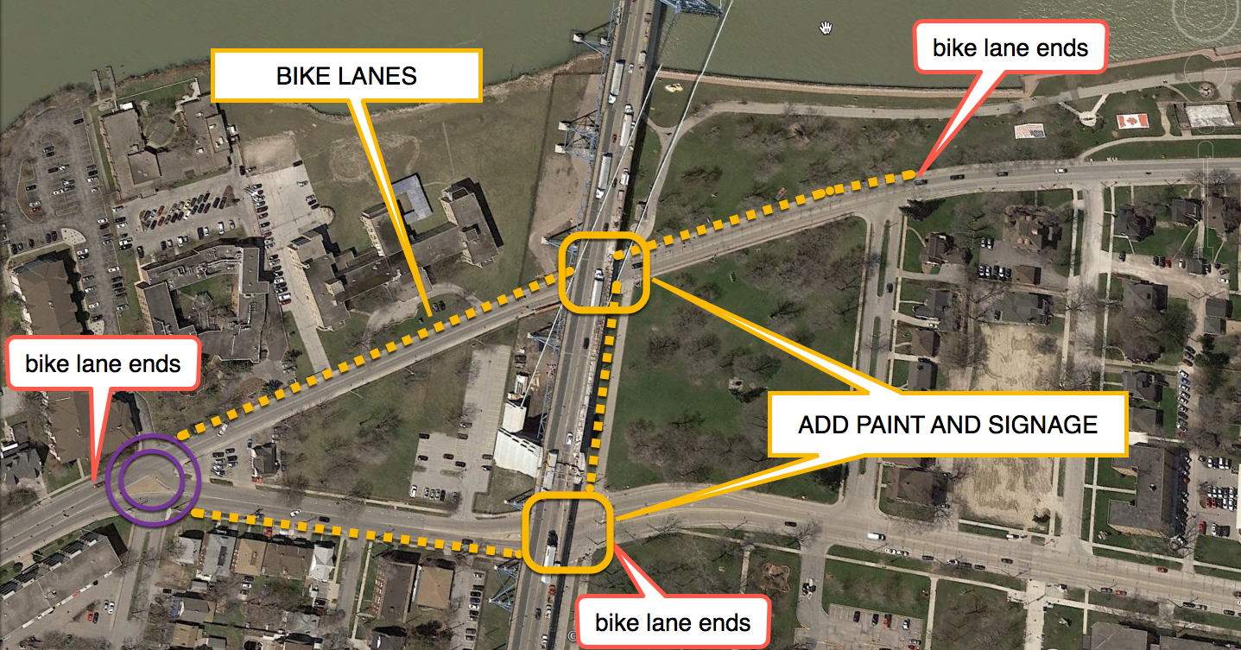
AMBASSADOR BRIDGE CONNECTION

Slide 8
Recommendation #2
Add bike lanes to all planned paved shoulders.

Slide 9
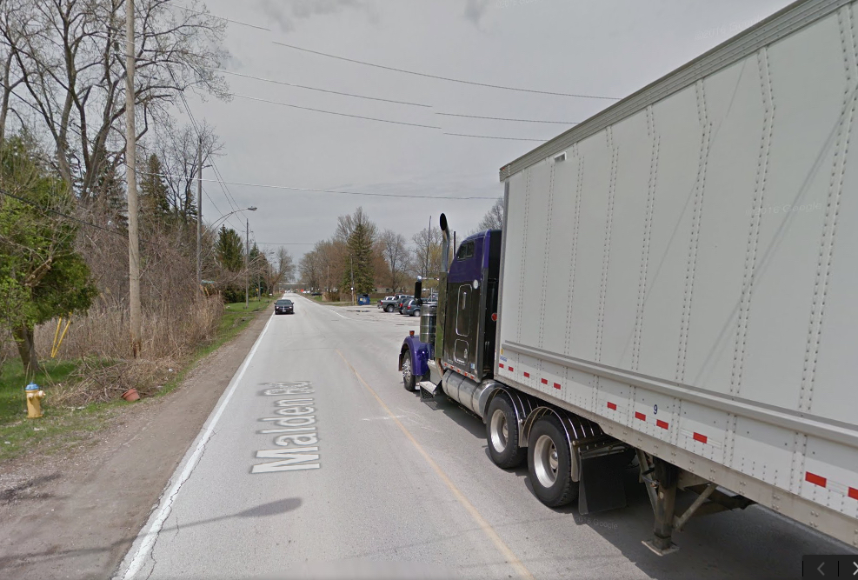
PAVED SHOULDERS
C2d – Malden Road
Armanda Street to Rt. Hon. Herb Gray Parkway Trails
$120,000
Very important link, high traffic, numerous trucks. At a minimum, bike lanes should be added.
Cost to add bike lanes $16,615
Perfect location for Windsor’s first separated bike lane.

Slide 10
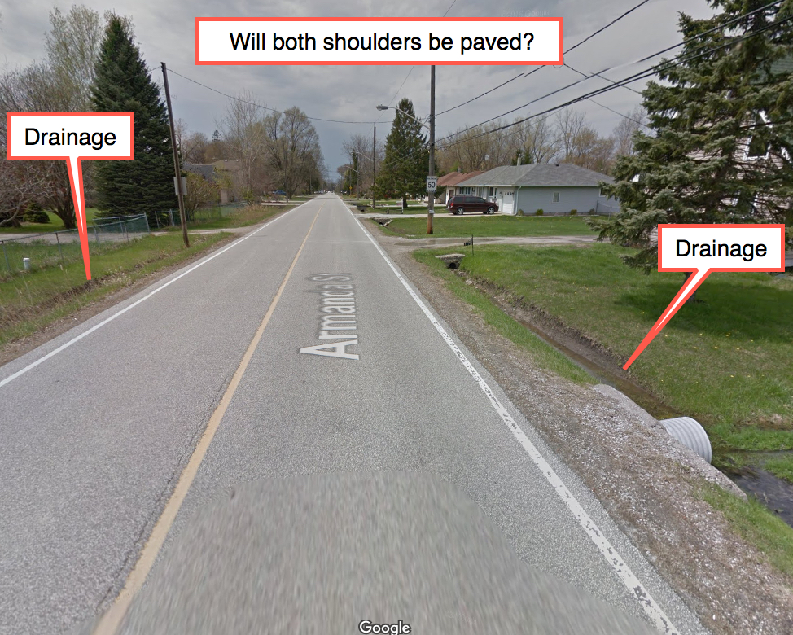
PAVED SHOULDERS
C2c – Armanda Street
Matchette Road to Malden Road
$300,000
Necessary as a connection but a low traffic street. This was identified as a Signed Route in the BUMP
Will both shoulders be paved? Drainage issues? Utility relocates?
Cost to add bike lanes $34,106

Slide 11
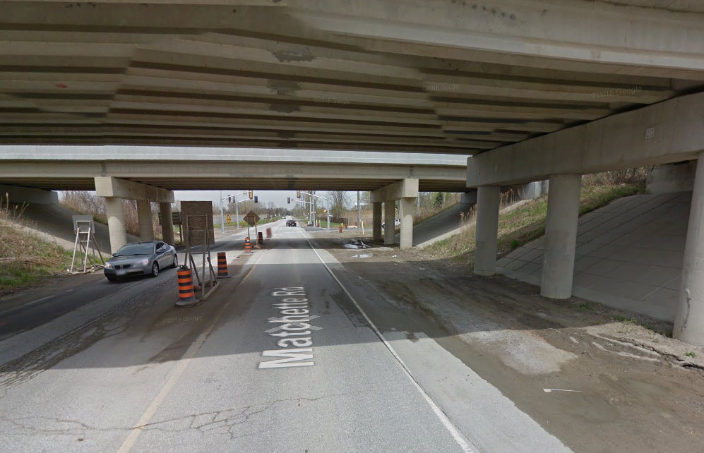
PAVED SHOULDERS
C2e - Matchette Road
Broadway Street to Carmichael Road (Malden Park entrance)
$360,000
Critical to get this done.
Will both sides be paved?
Heavy traffic, high speeds - this section needs bike lanes added (minimum)
Make sure there are no interruptions.
Cost to add bike lanes $40,810

Slide 12
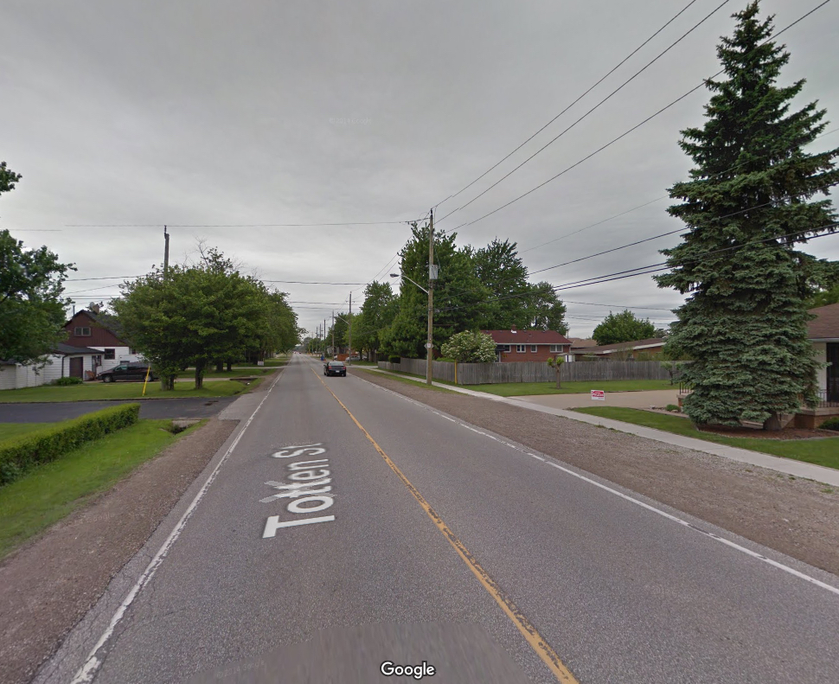
PAVED SHOULDERS & SHARROWS
C9a – Totten Road
Campbell to Huron Church
Modified route in order to connect to bike lanes on Prince Road and Campbell Ave.
In conjunction with proposed planned watermain on Totten Rd. from Betts Avenue to Mark Avenue
$640,000
Why is the cost of this project so much higher than the average of $260/lm for other paved shoulder projects? Transportation route. Includes a school zone.
Cost to add bike lanes $43,434

Slide 13
Recommendation #3
ADD bike lanes on -
MCDOUGALL from Giles to University and
UNIVERSITY From McDougall to Bruce
to connect downtown…

Slide 14
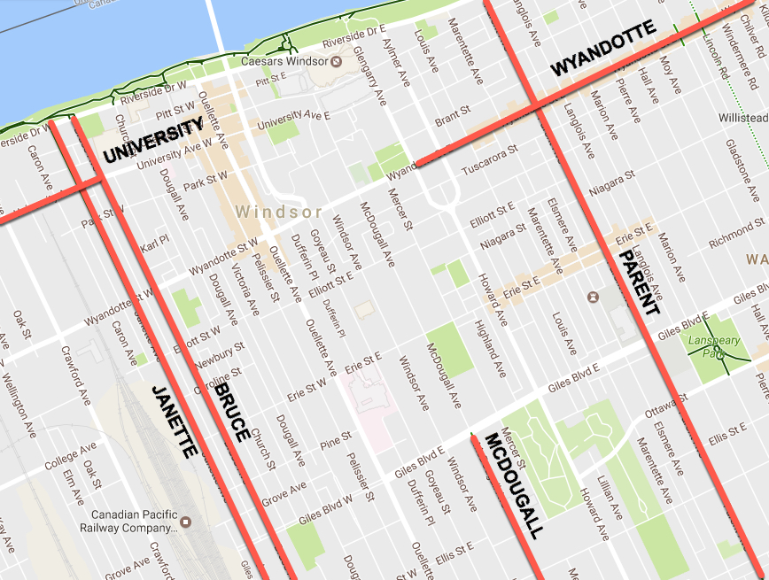
EXISTING bike lanes serving the downtown core

Slide 15
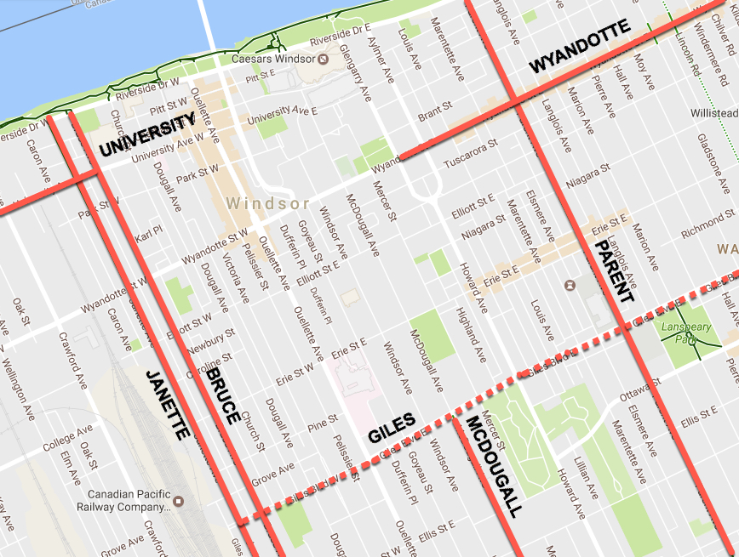
EXISTING bike lanes serving the downtown core
GILES Boulevard from Gladstone to Janette to be added Per CR627

Slide 16
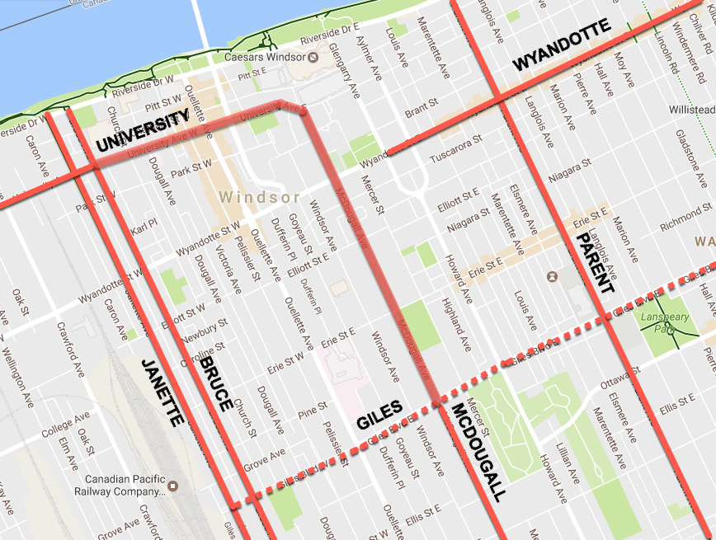
EXISTING bike lanes serving the downtown core
GILES Boulevard from Gladstone to Janette to be added Per CR627
COMPLETE downtown sections of McDougall/University

Slide 17
How do we pay for these extra
bike lanes?
The full cost of the extra bike lanes could be easily funded by cancelling or postponing either C3 or C6 (bridges).

Slide 18
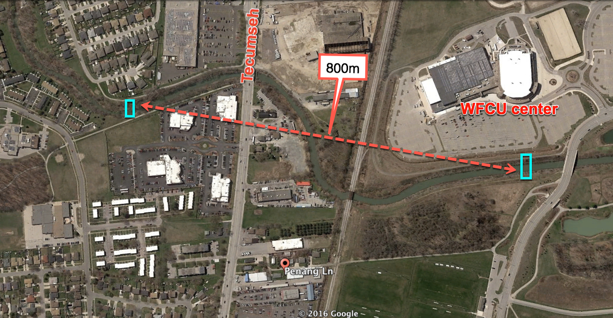
TEEDIE BRIDGE AND PENANG LANE BRIDGE

Slide 19
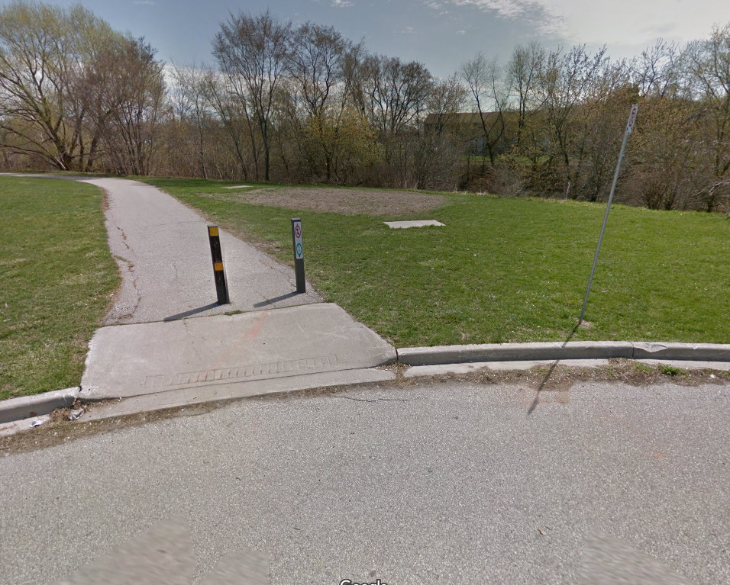
BRIDGE
C3 - Teedie Bridge
Connecting multi-use trail north of Esplanade Drive to multi-use trail east of Hawthorne Crescent
$280,000

Slide 20
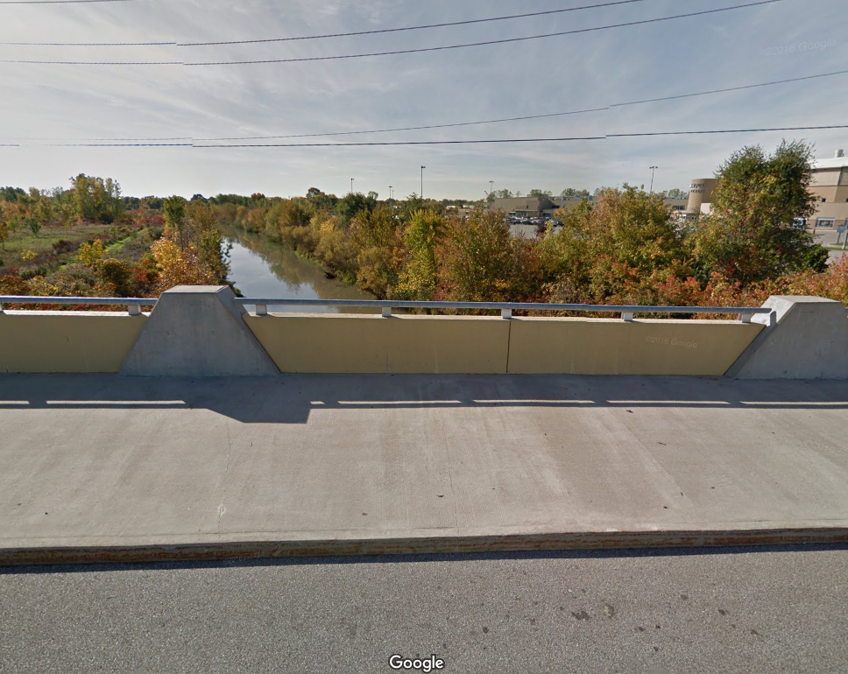
BRIDGE
C6 – Bridge connecting Penang Lane multi-use trail to the WFCU Centre
$300,000
Not critical cycling infrastructure

Slide 21
How do we pay for these extra bike lanes?
PROJECT NAME | COST TO ADD BIKE LANES |  | PROJECT NAME | COST
C2d - MALDEN ROAD | $16,615 |  | C6 PENANG BRIDGE | $300,000
C2c - ARMANDA ST | $34,106
C2e - MATCHETTE RD | $40,810
C9a - TOTTEN RD | $43,434
C2b - MATCHETTE | $933
MCDOUGALL ST | $41,685
UNIVERSITY AVE | $26,818
TOTAL | $204,400 |  | TOTAL | $300,000

Slide 22
Recommendation #4
Include intersection treatments in bike lane construction. Bike lanes must not end abruptly before an intersection. Including directional paint, bike boxes and signage for drivers and cyclists at high traffic intersections will significantly improve safety for all. (ex. McDougall & University E., Totten, Prince & Sandwich)

Slide 23
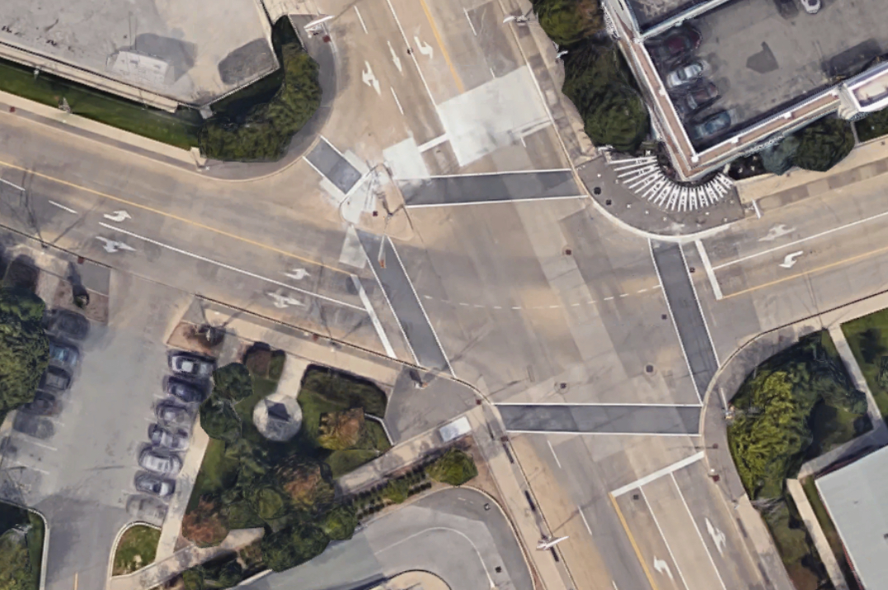
MCDOUGALL/UNIVERSITY INTERSECTION
Recommend
Including directional paint, bike boxes and signage for drivers and cyclists at high traffic intersections

Slide 24
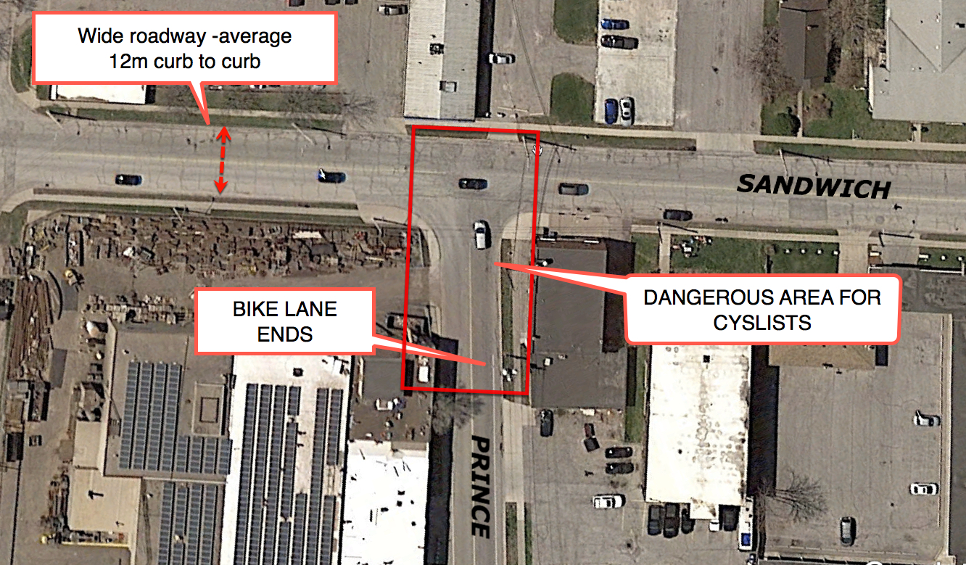
SANDWICH ST/PRINCE RD INTERSECTION

Slide 25
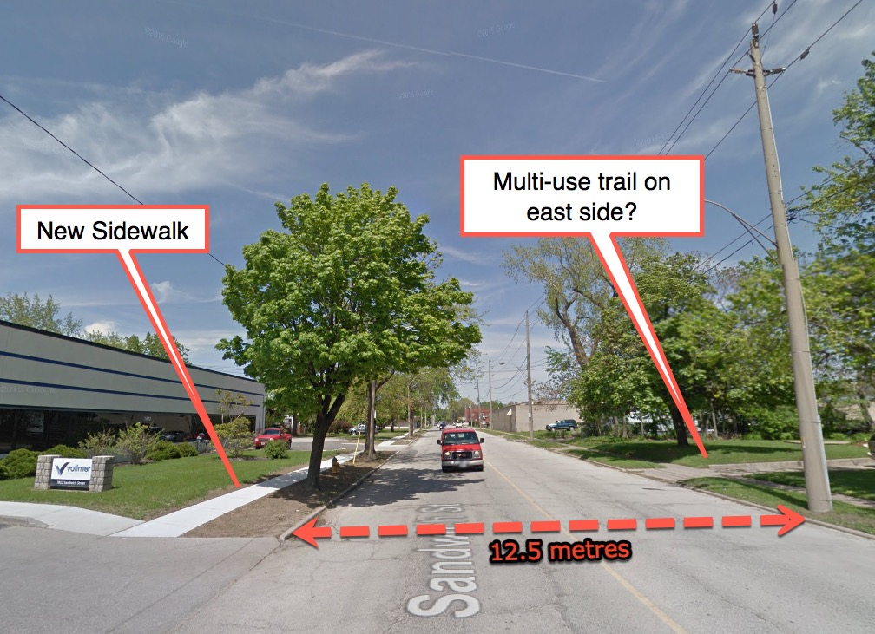
MULTI-USE TRAIL
C10 – Sandwich St
Ojibway Parkway to Prince
Road
Rerouted around the new Bridge Plaza Perimeter Road to include cycling facilities and potential future access to the bridge at no cost to the City.
Facility Type – Multi-Use Trail
$266,000
This road is an average of +/-12m wide, more than enough for on-road bike lanes. Change from trail to bike lanes? (the cost of bike lanes = $11,950)? Use savings of $254,048 for urgent cycle facilities?

Slide 26
Recommendation #5
Ensure new cycling infrastructure connects with existing bike lanes and trails. (ex. C7-Bruce Ave to Jackson Park, Ambassador Bridge area, C10-Prince/Sandwich St)

Slide 27
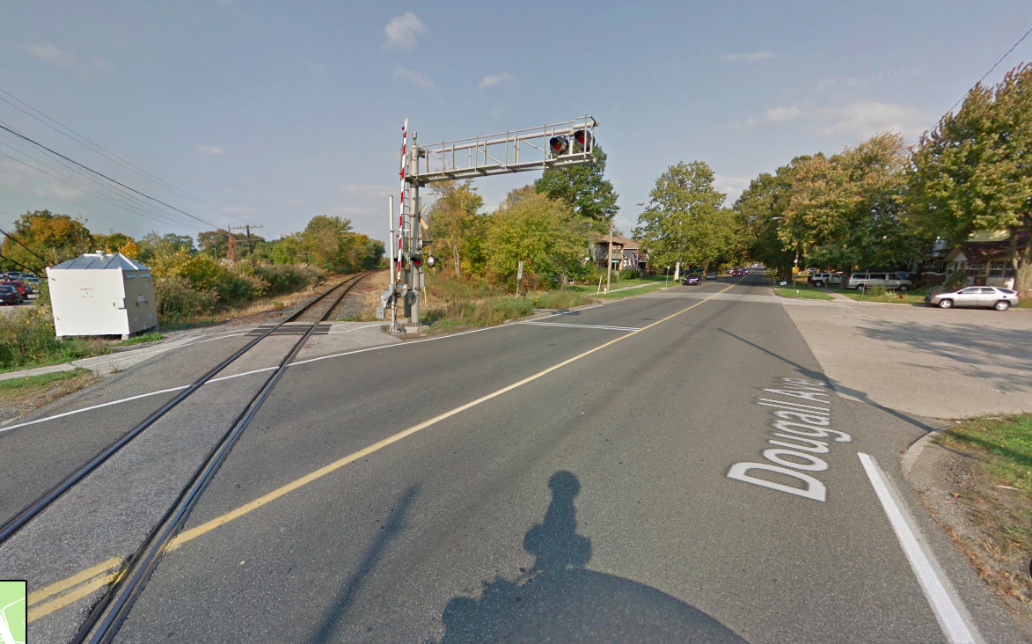
MULTI-USE TRAIL
C7 – Connection Bruce Avenue to Jackson Park,
along rail corridor
Facility Type: Multi-Use Trail
$160,000
Will this trail connect all the way to the Bruce Avenue Bike lane north of Tecumseh?
Will there be any help for the cyclist crossing Dougall Ave to get to the trail?

Slide 28
Recommendation #6
Update the BUMP or - at a minimum -
Schedule an annual BUMP review and community consultation to track progress on the BUMP’s 42 recommendations and discuss future cycling priorities and infrastructure plans. Participants should include the City, WBC, WEbike and the public.
This would improve community support and avoid after-the-fact concerns and questions.

Slide 29
RECOMMENDATIONS
Connect cycling infrastructure under the Ambassador Bridge. Add on-road directional paint and signage at intersections. Ensure cycling infrastructure is an integral part of the new Sandwich Street roundabout.
Add (BUMP identified) bike lanes; on McDougall from Giles to University and
            on University From McDougall to Bruce
Add bike lanes to all planned paved shoulders. Additional cost of all extra bike lanes could be easily funded by postponing and using the funds from either C3 or C6 (bridges).
Include intersection treatments in bike lane construction. Bike lanes must not end abruptly before an intersection. Including directional paint and signage for drivers and cyclists at medium to high traffic intersections will significantly improve safety for all. (ex. McDougall/University E)
Ensure new cycling infrastructure connects with existing bike lanes and trails. (ex. C7-Bruce Ave to Jackson Park, Ambassador Bridge area, C10-Prince/Sandwich St)
Update the BUMP or - at a minimum - Schedule an annual BUMP review and community consultation to track progress on the BUMP’s 42 recommendations and discuss future cycling priorities and infrastructure plans. Participants should include the City, WBC, WEbike and the public.

